Slide 1
Chance variation and the
Normal ( Gaussian ) model

Slide 2
Types of Variation
Chance causes of variation
Assignable causes of variation
(Shewhart)

Slide 3
Types of Variation
Chance causes of variation are the many
individually negligible and unpredictable
but
collectively influential
factors that affect a process or system.
Assignable causes of variation are the few
individually influential and predictable effect
factors that affect a process or system.

Slide 4
Tennis Ball Manufacturing Process
Variation in Manufacturing Processes
    Process flow chart
    Stratification
    Graphical comparison
    variation within and between strata

Slide 5
Tennis ball manufacturing process
Mixer
Cup
Mould
Flow chart
Edge
Buffer
Press
1
Press
2
Press
3
Press
4
Buffer
Gluer
Felter
1
Felter
2
Felter
3
Packing
Line

Slide 6
Sources of variation
rubber, a natural product;
chemical additives:
  properties;
  amounts;
pellet size;
extent of edge buffing;
temperature within the presses;
pressure within the presses;
extent of buffing and glueing
properties of felt cover
- etc., etc.

Slide 7
Trouble shooting exercise:
Comparison of output from four presses
186 cores in each of four presses taken from a single production run
diameters measured and recorded

Slide 8
Press 1
109 | 104 | 100 | 100 | 102 | 102 | 82 | 77 | 78 | 85 | 88 | 78
114 | 112 | 100 | 102 | 112 | 100 | 94 | 80 | 78 | 90 | 82 | 88
100 | 115 | 110 | 94 | 90 | 98 | 95 | 88 | 88 | 89 | 76 | 88
82 | 102 | 86 | 94 | 102 | 94 | 82 | 78 | 86 | 78 | 82 | 82
96 | 98 | 85 | 94 | 102 | 96 | 82 | 82 | 84 | 94 | 100 | 91
90 | 92 | 83 | 88 | 85 | 98 | 84 | 92 | 80 | 84 | 80 | 80
94 | 102 | 101 | 98 | 104 | 102 | 82 | 82 | 88 | 88 | 86 | 91
90 | 97 | 96 | 90 | 95 | 88 | 88 | 92 | 94 | 102 | 88 | 98
88 | 80 | 80 | 90 | 78 | 92 | 92 | 91 | 80 | 88 | 82 | 80
92 | 88 | 92 | 100 | 100 | 88 | 87 | 90 | 87 | 94 | 90 | 86
88 | 90 | 92 | 90 | 77 | 90 | 102 | 94 | 96 | 90 | 90 | 82
90 | 90 | 90 | 88 | 80 | 88 | 82 | 86 | 82 | 88 | 79 | 92
88 | 88 | 92 | 85 | 94 | 92 | 90 | 97 | 108 | 105 | 98 | 100
90 | 80 | 78 | 84 | 85 | 84 | 98 | 102 | 98 | 94 | 96 | 78
88 | 78 | 88 | 93 | 78 | 82 | 98 | 97 | 92 | 84 | 88 | 104
98 | 82 | 92 | 82 | 84 | 82

Slide 9
Press 2
98 | 96 | 94 | 102 | 90 | 103 | 94 | 82 | 72 | 74 | 73 | 77
101 | 106 | 90 | 98 | 101 | 96 | 83 | 83 | 80 | 83 | 81 | 87
106 | 106 | 111 | 104 | 104 | 89 | 103 | 87 | 96 | 103 | 103 | 83
90 | 89 | 90 | 95 | 90 | 91 | 76 | 77 | 77 | 76 | 82 | 80
97 | 96 | 92 | 87 | 110 | 98 | 80 | 87 | 86 | 92 | 102 | 96
96 | 93 | 87 | 86 | 83 | 88 | 85 | 80 | 82 | 73 | 78 | 79
87 | 91 | 96 | 88 | 90 | 76 | 78 | 82 | 71 | 73 | 79 | 83
97 | 96 | 99 | 96 | 99 | 84 | 89 | 88 | 97 | 103 | 94 | 88
85 | 78 | 82 | 90 | 88 | 81 | 90 | 79 | 80 | 78 | 77 | 79
84 | 80 | 90 | 87 | 90 | 95 | 82 | 72 | 81 | 91 | 95 | 94
105 | 97 | 91 | 91 | 85 | 71 | 90 | 86 | 74 | 90 | 83 | 78
76 | 74 | 80 | 83 | 84 | 85 | 79 | 83 | 80 | 82 | 86 | 87
89 | 86 | 92 | 90 | 96 | 96 | 95 | 93 | 106 | 101 | 95 | 90
88 | 91 | 86 | 80 | 76 | 73 | 84 | 90 | 86 | 80 | 96 | 90
78 | 77 | 79 | 76 | 87 | 91 | 89 | 85 | 94 | 93 | 97 | 98
81 | 100 | 94 | 102 | 99 | 95

Slide 10
Press 3
100 | 112 | 100 | 102 | 104 | 110 | 72 | 64 | 75 | 80 | 82 | 88
111 | 108 | 110 | 114 | 112 | 101 | 94 | 102 | 100 | 78 | 88 | 88
100 | 100 | 79 | 90 | 90 | 92 | 74 | 74 | 70 | 68 | 74 | 74
100 | 82 | 92 | 94 | 100 | 100 | 72 | 88 | 72 | 79 | 90 | 90
104 | 90 | 90 | 90 | 92 | 86 | 94 | 98 | 82 | 87 | 74 | 80
80 | 102 | 90 | 88 | 97 | 98 | 68 | 68 | 70 | 72 | 72 | 70
94 | 100 | 102 | 110 | 110 | 92 | 80 | 79 | 84 | 90 | 92 | 86
88 | 84 | 88 | 88 | 80 | 90 | 81 | 82 | 79 | 69 | 69 | 74
82 | 77 | 82 | 92 | 92 | 94 | 68 | 74 | 70 | 74 | 76 | 64
102 | 108 | 110 | 110 | 100 | 88 | 74 | 80 | 88 | 80 | 100 | 81
80 | 82 | 80 | 80 | 80 | 77 | 90 | 74 | 70 | 74 | 74 | 78
88 | 88 | 92 | 100 | 110 | 102 | 64 | 74 | 70 | 74 | 94 | 74
82 | 84 | 86 | 88 | 82 | 68 | 80 | 92 | 82 | 88 | 80 | 80
80 | 78 | 74 | 84 | 74 | 88 | 90 | 64 | 74 | 70 | 74 | 70
90 | 100 | 99 | 104 | 104 | 88 | 74 | 74 | 80 | 84 | 90 | 90
80 | 82 | 80 | 72 | 78 | 72

Slide 11
Press 4
78 | 74 | 86 | 81 | 89 | 86 | 78 | 74 | 79 | 74 | 78 | 71
86 | 86 | 84 | 88 | 86 | 84 | 74 | 80 | 74 | 69 | 72 | 68
88 | 82 | 89 | 78 | 74 | 77 | 88 | 77 | 82 | 84 | 80 | 68
75 | 81 | 72 | 76 | 79 | 80 | 70 | 66 | 70 | 70 | 71 | 70
66 | 64 | 76 | 72 | 74 | 76 | 68 | 67 | 70 | 70 | 76 | 78
88 | 81 | 80 | 72 | 80 | 70 | 84 | 80 | 70 | 70 | 75 | 74
73 | 76 | 81 | 77 | 71 | 76 | 82 | 75 | 68 | 73 | 64 | 76
74 | 85 | 62 | 80 | 88 | 84 | 76 | 88 | 86 | 84 | 78 | 88
75 | 73 | 73 | 72 | 75 | 79 | 78 | 81 | 80 | 78 | 71 | 78
75 | 73 | 64 | 67 | 67 | 69 | 79 | 74 | 71 | 72 | 86 | 90
71 | 82 | 87 | 79 | 86 | 69 | 77 | 73 | 71 | 74 | 82 | 78
71 | 73 | 72 | 70 | 74 | 69 | 80 | 85 | 80 | 74 | 77 | 72
68 | 71 | 64 | 72 | 75 | 71 | 79 | 78 | 84 | 88 | 97 | 94
74 | 79 | 74 | 76 | 78 | 66 | 86 | 84 | 86 | 90 | 87 | 90
73 | 74 | 72 | 72 | 73 | 66 | 83 | 84 | 83 | 82 | 88 | 85
62 | 62 | 69 | 68 | 80 | 80

Slide 12
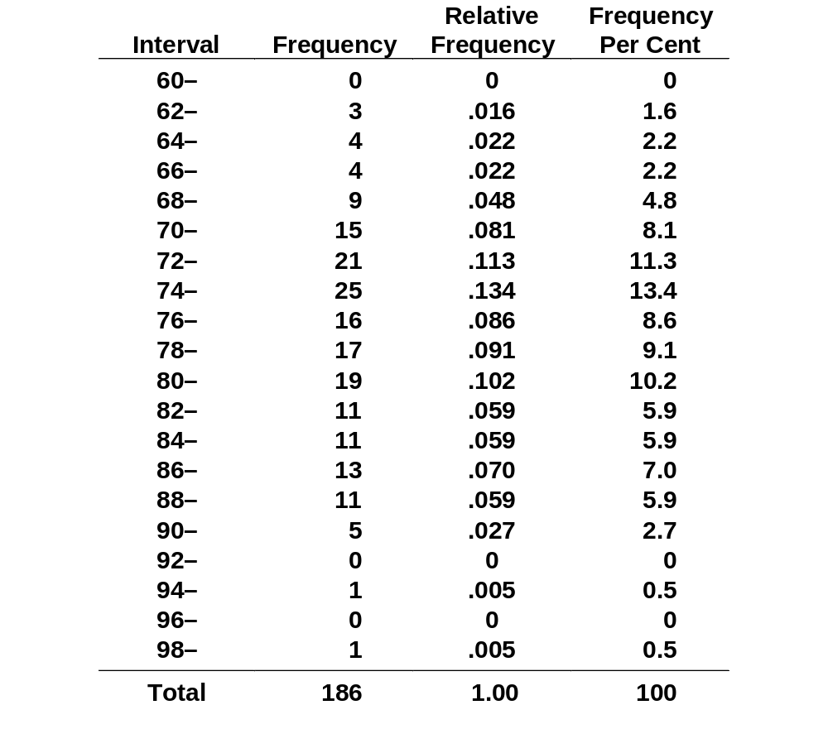
Frequency distribution of tennis ball diameters; Press 4

Slide 13
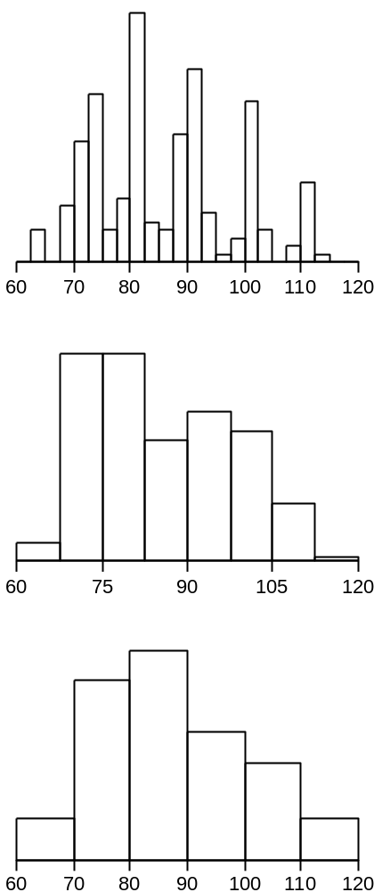
Three histograms of Press 3 Diameters

Slide 14
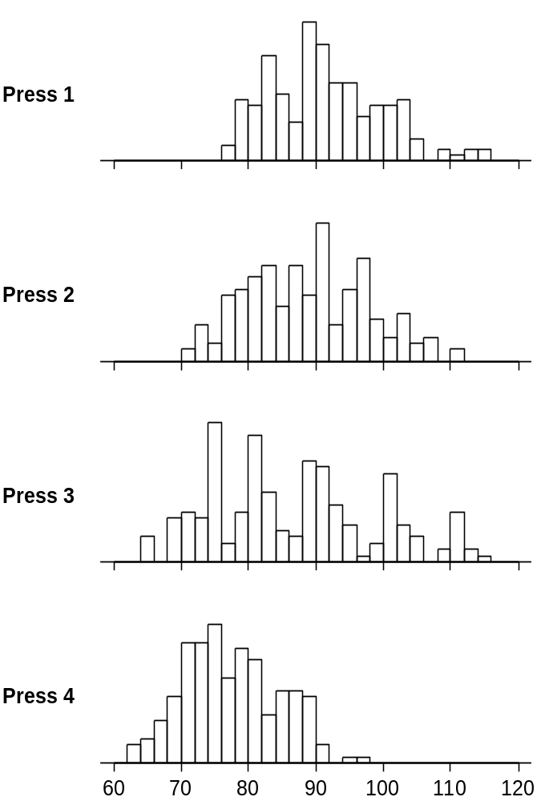
Histograms of Tennis Ball Diameters, stratified by Press

Slide 15
Non-conformance rates
How many diameters are
less than 70?
bigger than 100?
Press 1 12%
Press 2 11%
Press 3 19%
Press 4 13%

Slide 16
What-if?
how will the non-conformance rate change in response to a range of changes in centre and spread?
how will the non-conformance rate change in response to possible changes in customers specifications?
what change in centre and reduction in spread are needed to achieve an acceptably low non-conformance rate?
what change in centre and reduction in spread are needed if the customer demands tighter specifications?

Slide 17
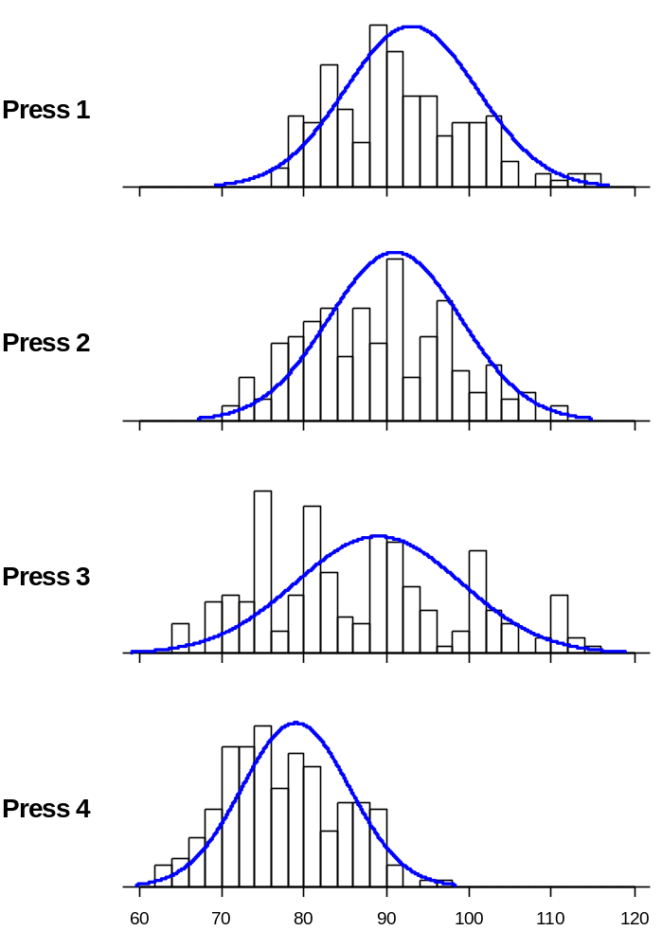
Histograms of Tennis Ball Diameters, with Normal frequency curves

Slide 18
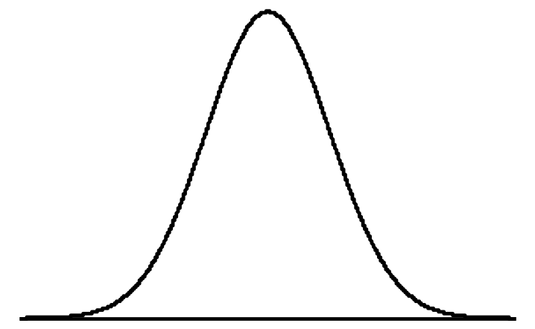
A Normal frequency curve

Slide 19
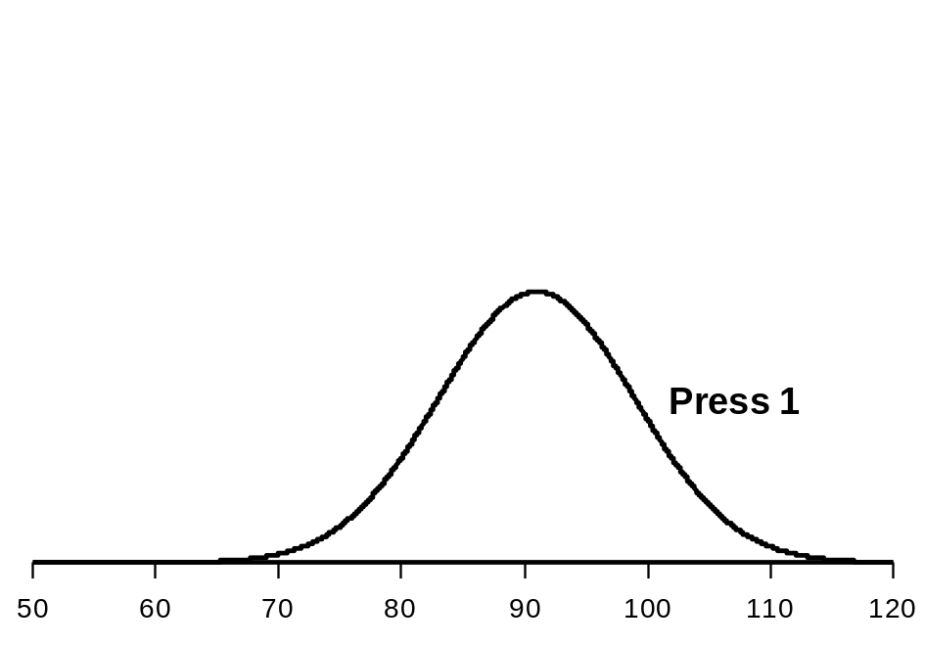
Adjustable Normal frequency curves

Slide 20
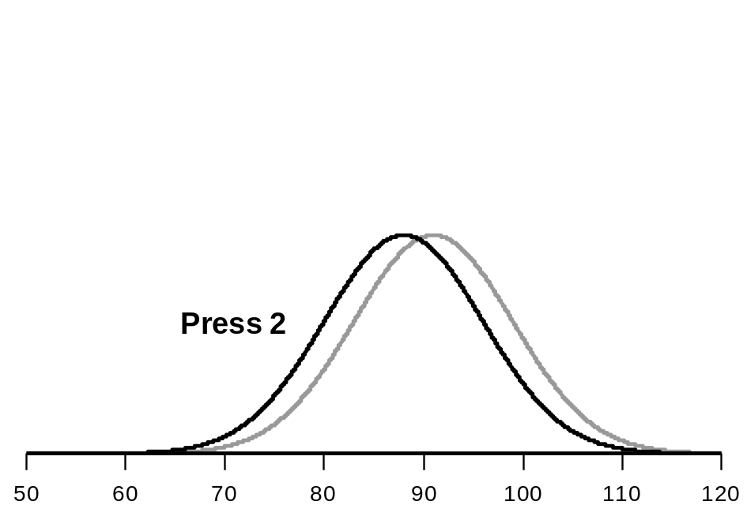
Adjustable Normal frequency curves

Slide 21
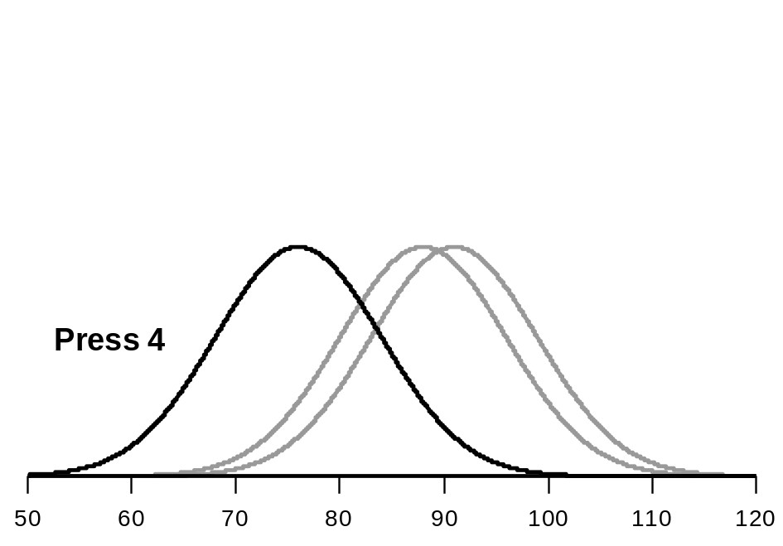
Adjustable Normal frequency curves

Slide 22
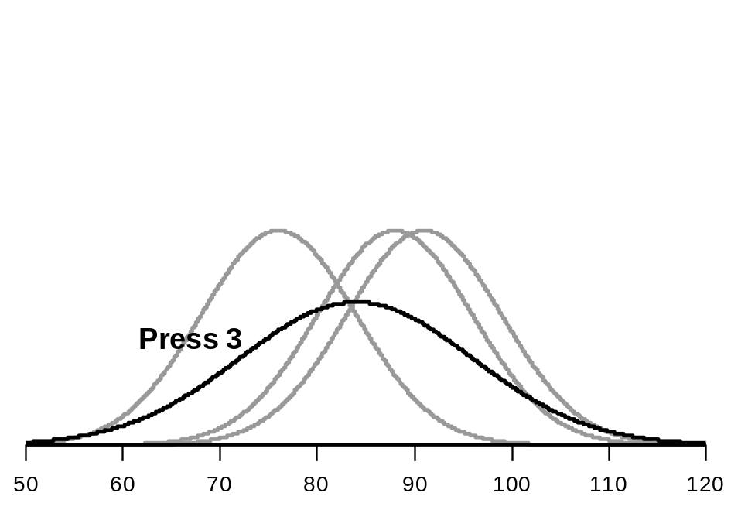
Adjustable Normal frequency curves

Slide 23
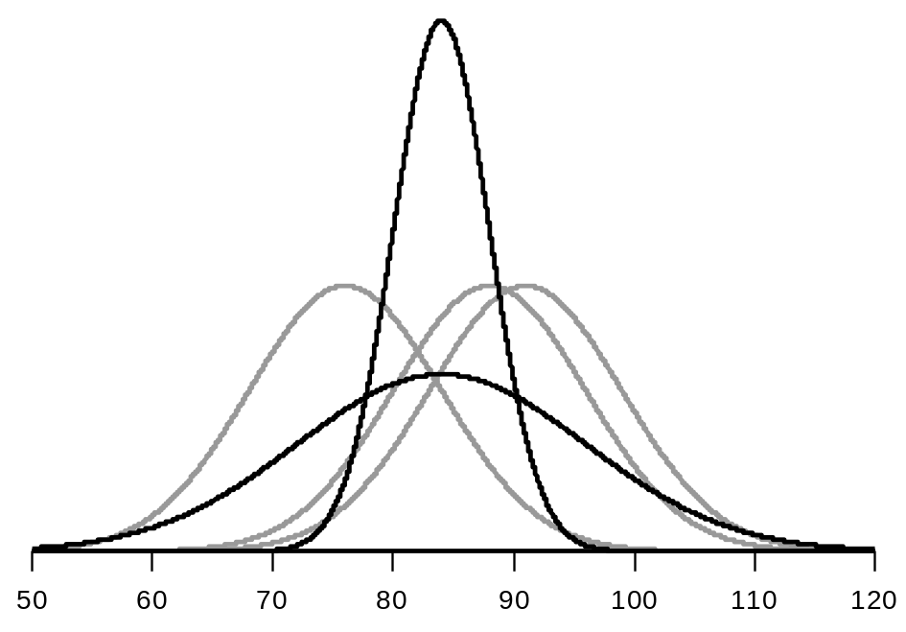
Adjustable Normal frequency curves

Slide 24
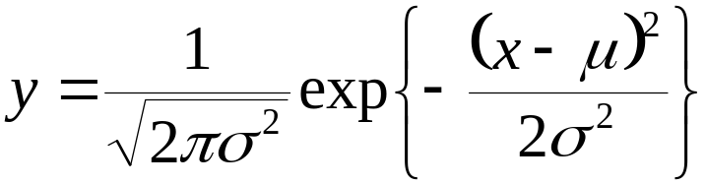
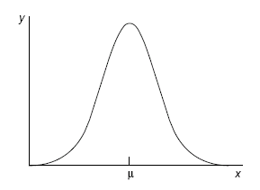
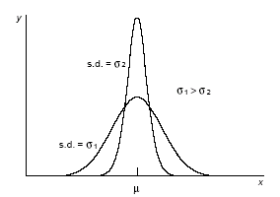
Parameters of the Normal model
Centre and Spread
Mean and Standard Deviation
μ and σ

Slide 25
What-if?
Study a range of Normal models
corresponding to
a range of means
and
a range of standard deviations

Slide 26
General statements:
In any normal distribution, approximately:
68% of observations lie within
[μ - 1σ, μ + 1σ]
95% of observations lie within
[μ - 2σ, μ + 2σ]
99% of observations lie within
[μ - 3σ, μ + 3σ]
Exact statements:
In any normal distribution, exactly:
68% of observations lie within
[μ - 1σ, μ + 1σ]
95% of observations lie within
[μ – 1.96σ, μ + 1.96σ]
99% of observations lie within [μ – 2.58σ, μ + 2.58σ]

Slide 27
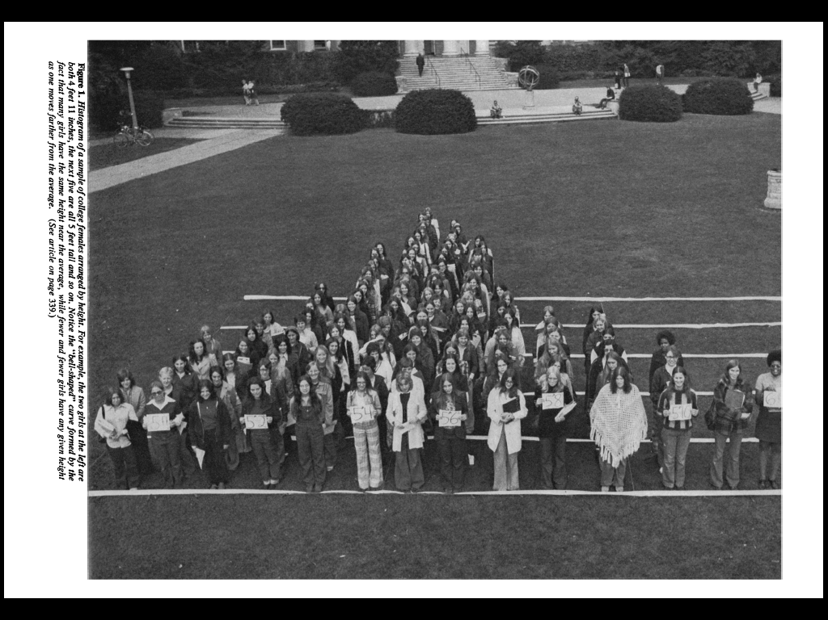

Slide 28
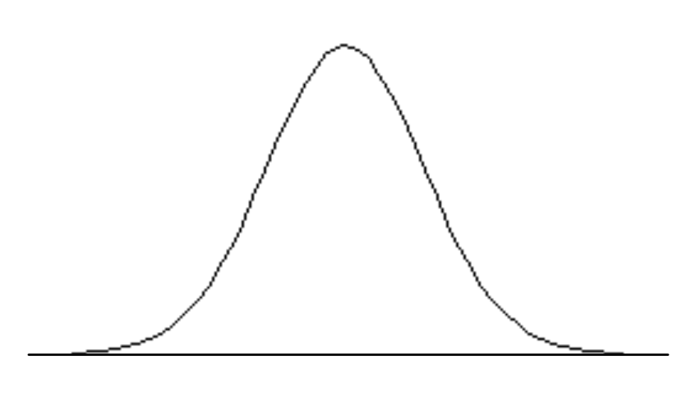
Example:
Suppose that women’s heights follow a normal distribution with mean 63.6 inches and standard deviation 2.5 inches.
95%
63.6
58.6
68.6

Slide 29
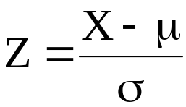
The Standard Normal Curve
13.5%
13.5%
X
Z
66.1
68.6
1.0
2.0
X has mean 63.6 and SD 2.5
X = 66.1 is 1 SD above the mean of 63.6
X = 68.6 is 2 SD above the mean of 63.6
X~N(μ,σ²) Z~N(0,1)

Slide 30
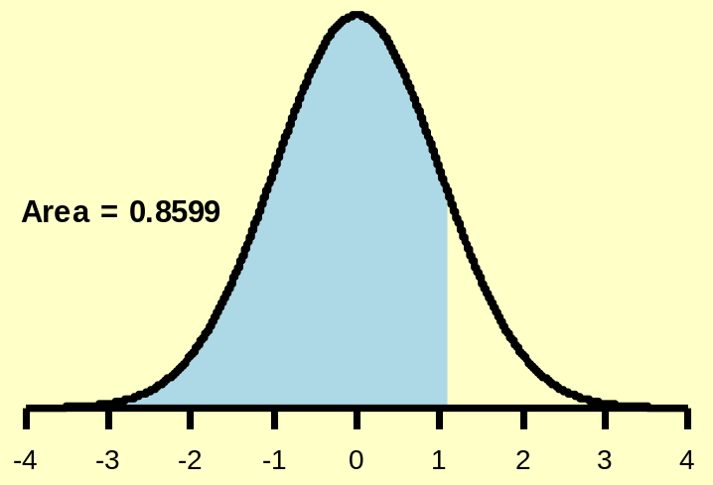
Example : Find the area less than z = +1.08 under the standard Normal Curve
z = 1.08
1.08 = 1.0 + 0.08 , so in the stats tables:
find 1.0 down the rows;
find 0.08 along the columns.

Slide 31
z | .00 | .01 | .02 | .03 | .04 | .05 | .06 | .07 | .08 | .09
0.0 | 0.5000 | 0.5040 | 0.5080 | 0.5120 | 0.5160 | 0.5199 | 0.5239 | 0.5279 | 0.5319 | 0.5359
0.1 | 0.5398 | 0.5438 | 0.5478 | 0.5517 | 0.5557 | 0.5596 | 0.5636 | 0.5675 | 0.5714 | 0.5753
0.2 | 0.5793 | 0.5832 | 0.5871 | 0.5910 | 0.5948 | 0.5987 | 0.6026 | 0.6064 | 0.6103 | 0.6141
0.3 | 0.6179 | 0.6217 | 0.6255 | 0.6293 | 0.6331 | 0.6368 | 0.6406 | 0.6443 | 0.6480 | 0.6517
0.4 | 0.6554 | 0.6591 | 0.6628 | 0.6664 | 0.6700 | 0.6736 | 0.6772 | 0.6808 | 0.6844 | 0.6879
0.5 | 0.6915 | 0.6950 | 0.6985 | 0.7019 | 0.7054 | 0.7088 | 0.7123 | 0.7157 | 0.7190 | 0.7224
0.6 | 0.7257 | 0.7291 | 0.7324 | 0.7357 | 0.7389 | 0.7422 | 0.7454 | 0.7486 | 0.7517 | 0.7549
0.7 | 0.7580 | 0.7611 | 0.7642 | 0.7673 | 0.7704 | 0.7734 | 0.7764 | 0.7794 | 0.7823 | 0.7852
0.8 | 0.7881 | 0.7910 | 0.7939 | 0.7967 | 0.7995 | 0.8023 | 0.8051 | 0.8078 | 0.8106 | 0.8133
0.9 | 0.8159 | 0.8186 | 0.8212 | 0.8238 | 0.8264 | 0.8289 | 0.8315 | 0.8340 | 0.8365 | 0.8389
1.0 | 0.8413 | 0.8438 | 0.8461 | 0.8485 | 0.8508 | 0.8531 | 0.8554 | 0.8577 | 0.8599 | 0.8621
1.1 | 0.8643 | 0.8665 | 0.8686 | 0.8708 | 0.8729 | 0.8749 | 0.8770 | 0.8790 | 0.8810 | 0.8830
1.2 | 0.8849 | 0.8869 | 0.8888 | 0.8907 | 0.8925 | 0.8944 | 0.8962 | 0.8980 | 0.8997 | 0.9015
1.3 | 0.9032 | 0.9049 | 0.9066 | 0.9082 | 0.9099 | 0.9115 | 0.9131 | 0.9147 | 0.9162 | 0.9177
1.4 | 0.9192 | 0.9207 | 0.9222 | 0.9236 | 0.9251 | 0.9265 | 0.9279 | 0.9292 | 0.9306 | 0.9319

Slide 32
Example : Find the area less than z = -2.53 under the standard Normal Curve
z = −2.53
z = 2.53
-4
-3
-2
-1
0
1
2
3
4
2.53 = 2.5 + 0.03 , so in the stats tables:
find 2.5 down the rows;
find 0.03 along the columns.

Slide 33
z | .00 | .01 | .02 | .03 | .04 | .05 | .06 | .07 | .08 | .09
0.0 | 0.5000 | 0.5040 | 0.5080 | 0.5120 | 0.5160 | 0.5199 | 0.5239 | 0.5279 | 0.5319 | 0.5359
0.1 | 0.5398 | 0.5438 | 0.5478 | 0.5517 | 0.5557 | 0.5596 | 0.5636 | 0.5675 | 0.5714 | 0.5753
0.2 | 0.5793 | 0.5832 | 0.5871 | 0.5910 | 0.5948 | 0.5987 | 0.6026 | 0.6064 | 0.6103 | 0.6141
0.3 | 0.6179 | 0.6217 | 0.6255 | 0.6293 | 0.6331 | 0.6368 | 0.6406 | 0.6443 | 0.6480 | 0.6517
0.4 | 0.6554 | 0.6591 | 0.6628 | 0.6664 | 0.6700 | 0.6736 | 0.6772 | 0.6808 | 0.6844 | 0.6879
0.5 | 0.6915 | 0.6950 | 0.6985 | 0.7019 | 0.7054 | 0.7088 | 0.7123 | 0.7157 | 0.7190 | 0.7224
0.6 | 0.7257 | 0.7291 | 0.7324 | 0.7357 | 0.7389 | 0.7422 | 0.7454 | 0.7486 | 0.7517 | 0.7549
: | : | : | : | : | : | : | : | : | : | :
: | : | : | : | : | : | : | : | : | : | :
2.2 | 0.9861 | 0.9864 | 0.9868 | 0.9871 | 0.9875 | 0.9878 | 0.9881 | 0.9884 | 0.9887 | 0.9890
2.3 | 0.9893 | 0.9896 | 0.9898 | 0.9901 | 0.9904 | 0.9906 | 0.9909 | 0.9911 | 0.9913 | 0.9916
2.4 | 0.9918 | 0.9920 | 0.9922 | 0.9925 | 0.9927 | 0.9929 | 0.9931 | 0.9932 | 0.9934 | 0.9936
2.5 | 0.9938 | 0.9940 | 0.9941 | 0.9943 | 0.9945 | 0.9946 | 0.9948 | 0.9949 | 0.9951 | 0.9952
2.6 | 0.9953 | 0.9955 | 0.9956 | 0.9957 | 0.9959 | 0.9960 | 0.9961 | 0.9962 | 0.9963 | 0.9964
2.7 | 0.9965 | 0.9966 | 0.9967 | 0.9968 | 0.9969 | 0.9970 | 0.9971 | 0.9972 | 0.9973 | 0.9974

Slide 34
Example : Find the area less than z = -2.53 under the standard Normal Curve
Area = 0.9943
z = −2.53
z = 2.53
-4
-3
-2
-1
0
1
2
3
4
Area = 1 - 0.9943
Area = 0.9943
= 0.0057
z = -2.53
z = -2.53
-4
-3
-2
-1
0
1
2
3
4
-4
-3
-2
-1
0
1
2
3
4

Slide 35
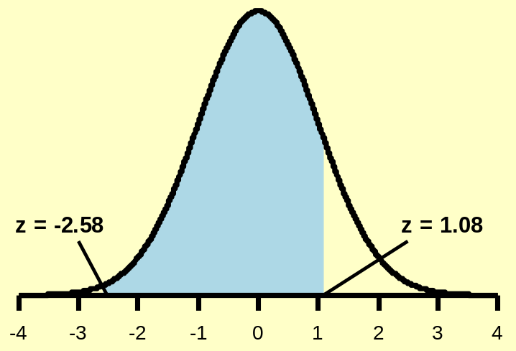
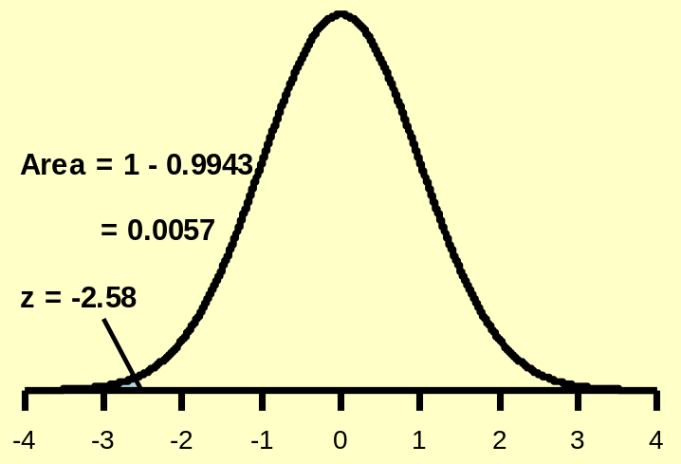
Find the area between −2.53 and 1.08.
Area = 0.8599
− 0.0057
= 0.8542

Slide 36
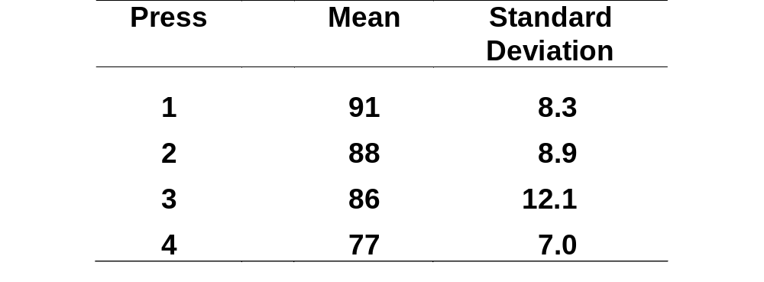
Illustration of calculations, based on means and standard deviations of tennis ball diameters

Slide 37
Calculate non-conformance rate for Press 1, μ = 91, σ = 8.3,
Specification limits: 70 to 100

Slide 38
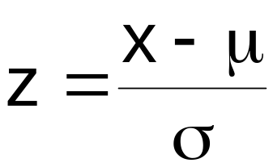
Standardisation
Given a measurement, X, from a process with mean μ and standard deviation σ, calculate
the standardised value of X,
the number of standard deviations by which X deviates from the mean
the deviation of X from the mean measured in standard deviation units

Slide 39
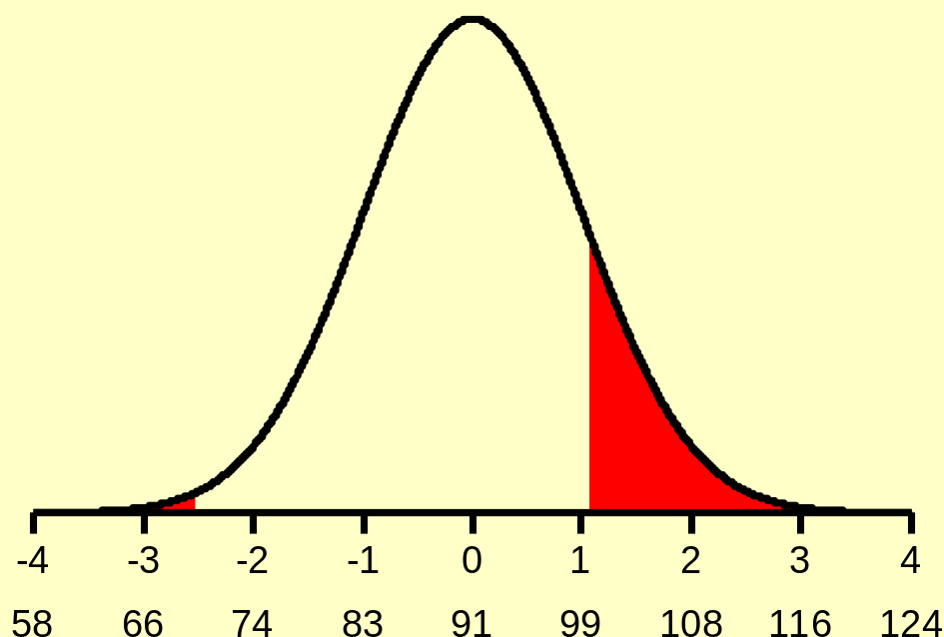
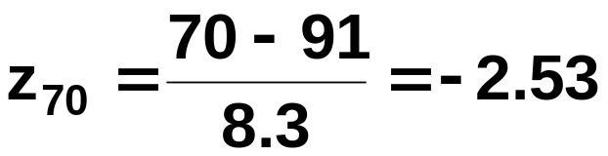
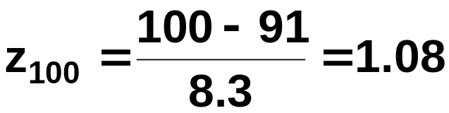
Calculate non-conformance rate for Press 1, μ = 91, σ = 8.3,
Specification limits: 70 to 100
z scale
x scale

Slide 40
Find the area between −2.53 and 1.08.
Area = 0.8599
− 0.0057
= 0.8542

Slide 41
A machine used to regulate the amount of dye dispensed can be set so that it discharges an average of μ = 5.3 mL of dye per can of paint. The amount of dye discharged is known to have a normal distribution with a standard deviation of 0.4 mL.
(a) What percentage of paint cans have a dye concentration greater than 6.0 mL?
(b) What percentage of paint cans have a dye concentration less
than 4.4 mL?
(c) What percentage of paint can have a dye concentration of between 4.4 mL and 6.0 mL?
(d) If more than 6 mL of dye is discharged when making a certain shade of blue, the shade is unacceptable. Determine the setting for μ so that only 1% of cans of paint will be unacceptable.
(e) Keeping μ fixed at 5.3 mL, what reduction in σ is required so that just 1% of cans of paint will be unacceptable.

Slide 42
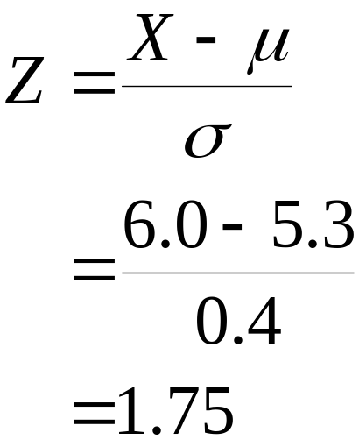
(a) What percentage of cans have a dye concentration > 6.0 mL?
σ = 0.4
σ = 1
X
Z
5.3
6.0
0
1.75
Look up 1.75 in the tables and we get…

Slide 43
z | .00 | .01 | .02 | .03 | .04 | .05 | .06 | .07 | .08 | .09
0.0 | 0.5000 | 0.5040 | 0.5080 | 0.5120 | 0.5160 | 0.5199 | 0.5239 | 0.5279 | 0.5319 | 0.5359
0.1 | 0.5398 | 0.5438 | 0.5478 | 0.5517 | 0.5557 | 0.5596 | 0.5636 | 0.5675 | 0.5714 | 0.5753
0.2 | 0.5793 | 0.5832 | 0.5871 | 0.5910 | 0.5948 | 0.5987 | 0.6026 | 0.6064 | 0.6103 | 0.6141
0.3 | 0.6179 | 0.6217 | 0.6255 | 0.6293 | 0.6331 | 0.6368 | 0.6406 | 0.6443 | 0.6480 | 0.6517
0.4 | 0.6554 | 0.6591 | 0.6628 | 0.6664 | 0.6700 | 0.6736 | 0.6772 | 0.6808 | 0.6844 | 0.6879
0.5 | 0.6915 | 0.6950 | 0.6985 | 0.7019 | 0.7054 | 0.7088 | 0.7123 | 0.7157 | 0.7190 | 0.7224
0.6 | 0.7257 | 0.7291 | 0.7324 | 0.7357 | 0.7389 | 0.7422 | 0.7454 | 0.7486 | 0.7517 | 0.7549
0.7 | 0.7580 | 0.7611 | 0.7642 | 0.7673 | 0.7704 | 0.7734 | 0.7764 | 0.7794 | 0.7823 | 0.7852
0.8 | 0.7881 | 0.7910 | 0.7939 | 0.7967 | 0.7995 | 0.8023 | 0.8051 | 0.8078 | 0.8106 | 0.8133
0.9 | 0.8159 | 0.8186 | 0.8212 | 0.8238 | 0.8264 | 0.8289 | 0.8315 | 0.8340 | 0.8365 | 0.8389
1.0 | 0.8413 | 0.8438 | 0.8461 | 0.8485 | 0.8508 | 0.8531 | 0.8554 | 0.8577 | 0.8599 | 0.8621
1.1 | 0.8643 | 0.8665 | 0.8686 | 0.8708 | 0.8729 | 0.8749 | 0.8770 | 0.8790 | 0.8810 | 0.8830
1.2 | 0.8849 | 0.8869 | 0.8888 | 0.8907 | 0.8925 | 0.8944 | 0.8962 | 0.8980 | 0.8997 | 0.9015
1.3 | 0.9032 | 0.9049 | 0.9066 | 0.9082 | 0.9099 | 0.9115 | 0.9131 | 0.9147 | 0.9162 | 0.9177
1.4 | 0.9192 | 0.9207 | 0.9222 | 0.9236 | 0.9251 | 0.9265 | 0.9279 | 0.9292 | 0.9306 | 0.9319
1.5 | 0.9332 | 0.9345 | 0.9357 | 0.9370 | 0.9382 | 0.9394 | 0.9406 | 0.9418 | 0.9429 | 0.9441
1.6 | 0.9452 | 0.9463 | 0.9474 | 0.9484 | 0.9495 | 0.9505 | 0.9515 | 0.9525 | 0.9535 | 0.9545
1.7 | 0.9554 | 0.9564 | 0.9573 | 0.9582 | 0.9591 | 0.9599 | 0.9608 | 0.9616 | 0.9625 | 0.9633
1.8 | 0.9641 | 0.9649 | 0.9656 | 0.9664 | 0.9671 | 0.9678 | 0.9686 | 0.9693 | 0.9699 | 0.9706
1.9 | 0.9713 | 0.9719 | 0.9726 | 0.9732 | 0.9738 | 0.9744 | 0.9750 | 0.9756 | 0.9761 | 0.9767
2.0 | 0.9772 | 0.9778 | 0.9783 | 0.9788 | 0.9793 | 0.9798 | 0.9803 | 0.9808 | 0.9812 | 0.9817

Slide 44
(a) What percentage of cans have a dye concentration > 6.0 mL?
σ = 0.4
σ = 1
X
Z
5.3
6.0
0
1.75
Look up 1.75 in the tables and we get… 0.9599
So that the area above
Z = +1.75 equals 0.0401
or 4.01%

Slide 45
Statistical tables:
  are a hangover from the early and middle parts of the last century;
  look old-fashioned, and make the subject of “statistics” look old-fashioned;
  are redundant if you know how to use some basic functions in EXCEL, or the stats package R;
  unfortunately, probably still needed for the purposes of teaching “large classes”.

Slide 46
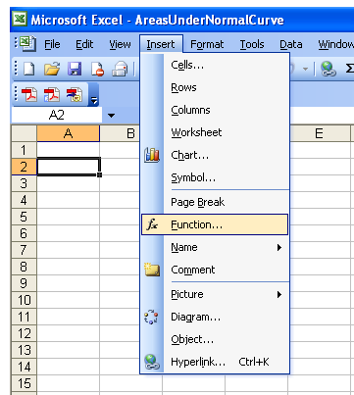

Slide 47
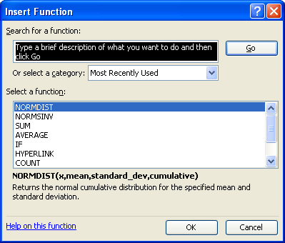

Slide 48
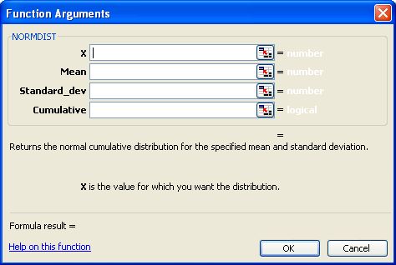

Slide 49
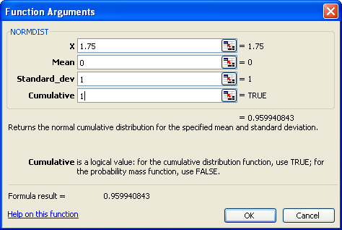

Slide 50
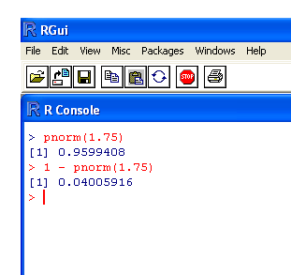
Even easier in the stats package R

Slide 51
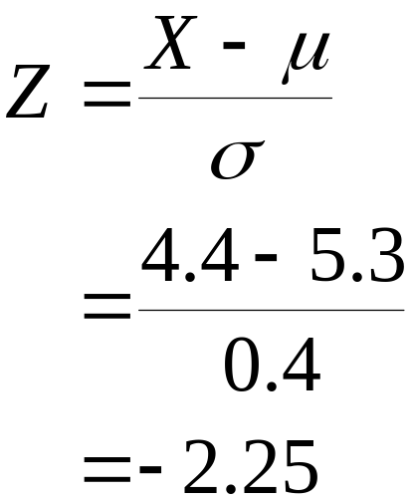
(b) What percentage of cans have a dye concentration < 4.4 mL?
σ = 0.4
σ = 1
X
Z
5.3
0
4.4
-2.25
Look up +2.25 in the tables and we get…

Slide 52
z | .00 | .01 | .02 | .03 | .04 | .05 | .06 | .07 | .08 | .09
0.0 | 0.5000 | 0.5040 | 0.5080 | 0.5120 | 0.5160 | 0.5199 | 0.5239 | 0.5279 | 0.5319 | 0.5359
0.1 | 0.5398 | 0.5438 | 0.5478 | 0.5517 | 0.5557 | 0.5596 | 0.5636 | 0.5675 | 0.5714 | 0.5753
0.2 | 0.5793 | 0.5832 | 0.5871 | 0.5910 | 0.5948 | 0.5987 | 0.6026 | 0.6064 | 0.6103 | 0.6141
0.3 | 0.6179 | 0.6217 | 0.6255 | 0.6293 | 0.6331 | 0.6368 | 0.6406 | 0.6443 | 0.6480 | 0.6517
0.4 | 0.6554 | 0.6591 | 0.6628 | 0.6664 | 0.6700 | 0.6736 | 0.6772 | 0.6808 | 0.6844 | 0.6879
0.5 | 0.6915 | 0.6950 | 0.6985 | 0.7019 | 0.7054 | 0.7088 | 0.7123 | 0.7157 | 0.7190 | 0.7224
0.6 | 0.7257 | 0.7291 | 0.7324 | 0.7357 | 0.7389 | 0.7422 | 0.7454 | 0.7486 | 0.7517 | 0.7549
: | : | : | : | : | : | : | : | : | : | :
: | : | : | : | : | : | : | : | : | : | :
2.0 | 0.9772 | 0.9778 | 0.9783 | 0.9788 | 0.9793 | 0.9798 | 0.9803 | 0.9808 | 0.9812 | 0.9817
2.1 | 0.9821 | 0.9826 | 0.9830 | 0.9834 | 0.9838 | 0.9842 | 0.9846 | 0.9850 | 0.9854 | 0.9857
2.2 | 0.9861 | 0.9864 | 0.9868 | 0.9871 | 0.9875 | 0.9878 | 0.9881 | 0.9884 | 0.9887 | 0.9890
2.3 | 0.9893 | 0.9896 | 0.9898 | 0.9901 | 0.9904 | 0.9906 | 0.9909 | 0.9911 | 0.9913 | 0.9916
2.4 | 0.9918 | 0.9920 | 0.9922 | 0.9925 | 0.9927 | 0.9929 | 0.9931 | 0.9932 | 0.9934 | 0.9936
2.5 | 0.9938 | 0.9940 | 0.9941 | 0.9943 | 0.9945 | 0.9946 | 0.9948 | 0.9949 | 0.9951 | 0.9952

Slide 53
(b) What percentage of cans have a dye concentration < 4.4 mL?
σ = 0.4
σ = 1
X
Z
5.3
0
4.4
-2.25
Look up +2.25 in the tables and we get… 0.9878
The area above Z = +2.25 (and by symmetry the area below Z = −2.25) equals 0.0122 or 1.22%

Slide 54
(c) What percentage of cans have a dye concentration between
4.4 mL and 6.0 mL?
5.3
5.3
4.4
6.0
1.22%
4.01%
94.77%
4.4
6.0

Slide 55
(d) What value for μ?
σ = 0.4
σ = 1
1%
μ
0
6.0

Slide 56
z | .00 | .01 | .02 | .03 | .04 | .05 | .06 | .07 | .08 | .09
0.0 | 0.5000 | 0.5040 | 0.5080 | 0.5120 | 0.5160 | 0.5199 | 0.5239 | 0.5279 | 0.5319 | 0.5359
0.1 | 0.5398 | 0.5438 | 0.5478 | 0.5517 | 0.5557 | 0.5596 | 0.5636 | 0.5675 | 0.5714 | 0.5753
0.2 | 0.5793 | 0.5832 | 0.5871 | 0.5910 | 0.5948 | 0.5987 | 0.6026 | 0.6064 | 0.6103 | 0.6141
0.3 | 0.6179 | 0.6217 | 0.6255 | 0.6293 | 0.6331 | 0.6368 | 0.6406 | 0.6443 | 0.6480 | 0.6517
0.4 | 0.6554 | 0.6591 | 0.6628 | 0.6664 | 0.6700 | 0.6736 | 0.6772 | 0.6808 | 0.6844 | 0.6879
0.5 | 0.6915 | 0.6950 | 0.6985 | 0.7019 | 0.7054 | 0.7088 | 0.7123 | 0.7157 | 0.7190 | 0.7224
0.6 | 0.7257 | 0.7291 | 0.7324 | 0.7357 | 0.7389 | 0.7422 | 0.7454 | 0.7486 | 0.7517 | 0.7549
: | : | : | : | : | : | : | : | : | : | :
: | : | : | : | : | : | : | : | : | : | :
2.0 | 0.9772 | 0.9778 | 0.9783 | 0.9788 | 0.9793 | 0.9798 | 0.9803 | 0.9808 | 0.9812 | 0.9817
2.1 | 0.9821 | 0.9826 | 0.9830 | 0.9834 | 0.9838 | 0.9842 | 0.9846 | 0.9850 | 0.9854 | 0.9857
2.2 | 0.9861 | 0.9864 | 0.9868 | 0.9871 | 0.9875 | 0.9878 | 0.9881 | 0.9884 | 0.9887 | 0.9890
2.3 | 0.9893 | 0.9896 | 0.9898 | 0.9901 | 0.9904 | 0.9906 | 0.9909 | 0.9911 | 0.9913 | 0.9916
2.4 | 0.9918 | 0.9920 | 0.9922 | 0.9925 | 0.9927 | 0.9929 | 0.9931 | 0.9932 | 0.9934 | 0.9936
2.5 | 0.9938 | 0.9940 | 0.9941 | 0.9943 | 0.9945 | 0.9946 | 0.9948 | 0.9949 | 0.9951 | 0.9952
Perhaps, Z = 2.325 ???

Slide 57
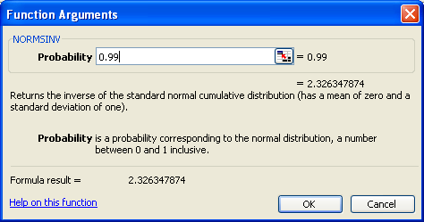
There is an EXCEL function NORMINV that does this exactly:
The exact value is 2.326, so our approximation of 2.325 isn’t too bad ☺

Slide 58
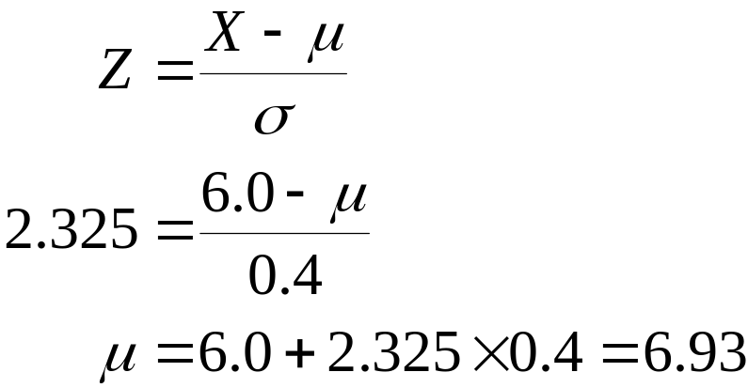
(d) What value for μ?
σ = 0.4
σ = 1
1%
μ
0
6.0
2.325

Slide 59
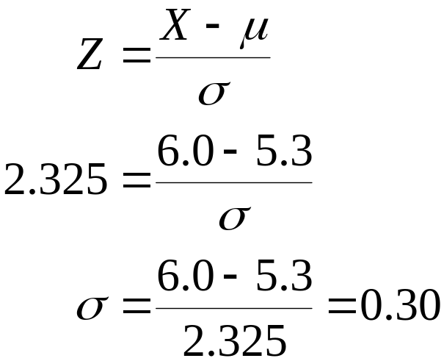
(e) What value for σ?
σ
σ = 1
1%
5.3
0
6.0
2.325

Slide 60
Example: Kev’s Garage
Kev’s garage sells a popular multi-grade motor oil. When the stock of this oil drops to 20 gallons, a replenishment order is placed.
The store manager is concerned that sales are being lost due to stock-outs while waiting for an order. It has been determined that lead-time demand is normally distributed with a mean of 15 gallons and a standard deviation of 6 gallons.
The manager would like to know the probability of a stock-out, that is, the probability P(X > 20) .

Slide 61
Example: Kev’s Garage
Standard Normal
Distribution
z = (X - μ )/σ
= (20 - 15)/6
= .83
Area = .2033
Area = .7967
Z
0
.83

Slide 62
Example: Kev’s Garage Extra
If the manager of Kev’s Garage wants the probability of a stock-out to be no more than .05, what should the reorder point be?
z represents the Z value cutting the tail area of .05
Area = .05
Area = .95
0
z

Slide 63
z | .00 | .01 | .02 | .03 | .04 | .05 | .06 | .07 | .08 | .09
0.0 | 0.5000 | 0.5040 | 0.5080 | 0.5120 | 0.5160 | 0.5199 | 0.5239 | 0.5279 | 0.5319 | 0.5359
0.1 | 0.5398 | 0.5438 | 0.5478 | 0.5517 | 0.5557 | 0.5596 | 0.5636 | 0.5675 | 0.5714 | 0.5753
0.2 | 0.5793 | 0.5832 | 0.5871 | 0.5910 | 0.5948 | 0.5987 | 0.6026 | 0.6064 | 0.6103 | 0.6141
0.3 | 0.6179 | 0.6217 | 0.6255 | 0.6293 | 0.6331 | 0.6368 | 0.6406 | 0.6443 | 0.6480 | 0.6517
0.4 | 0.6554 | 0.6591 | 0.6628 | 0.6664 | 0.6700 | 0.6736 | 0.6772 | 0.6808 | 0.6844 | 0.6879
0.5 | 0.6915 | 0.6950 | 0.6985 | 0.7019 | 0.7054 | 0.7088 | 0.7123 | 0.7157 | 0.7190 | 0.7224
0.6 | 0.7257 | 0.7291 | 0.7324 | 0.7357 | 0.7389 | 0.7422 | 0.7454 | 0.7486 | 0.7517 | 0.7549
0.7 | 0.7580 | 0.7611 | 0.7642 | 0.7673 | 0.7704 | 0.7734 | 0.7764 | 0.7794 | 0.7823 | 0.7852
0.8 | 0.7881 | 0.7910 | 0.7939 | 0.7967 | 0.7995 | 0.8023 | 0.8051 | 0.8078 | 0.8106 | 0.8133
0.9 | 0.8159 | 0.8186 | 0.8212 | 0.8238 | 0.8264 | 0.8289 | 0.8315 | 0.8340 | 0.8365 | 0.8389
1.0 | 0.8413 | 0.8438 | 0.8461 | 0.8485 | 0.8508 | 0.8531 | 0.8554 | 0.8577 | 0.8599 | 0.8621
1.1 | 0.8643 | 0.8665 | 0.8686 | 0.8708 | 0.8729 | 0.8749 | 0.8770 | 0.8790 | 0.8810 | 0.8830
1.2 | 0.8849 | 0.8869 | 0.8888 | 0.8907 | 0.8925 | 0.8944 | 0.8962 | 0.8980 | 0.8997 | 0.9015
1.3 | 0.9032 | 0.9049 | 0.9066 | 0.9082 | 0.9099 | 0.9115 | 0.9131 | 0.9147 | 0.9162 | 0.9177
1.4 | 0.9192 | 0.9207 | 0.9222 | 0.9236 | 0.9251 | 0.9265 | 0.9279 | 0.9292 | 0.9306 | 0.9319
1.5 | 0.9332 | 0.9345 | 0.9357 | 0.9370 | 0.9382 | 0.9394 | 0.9406 | 0.9418 | 0.9429 | 0.9441
1.6 | 0.9452 | 0.9463 | 0.9474 | 0.9484 | 0.9495 | 0.9505 | 0.9515 | 0.9525 | 0.9535 | 0.9545
1.7 | 0.9554 | 0.9564 | 0.9573 | 0.9582 | 0.9591 | 0.9599 | 0.9608 | 0.9616 | 0.9625 | 0.9633
1.8 | 0.9641 | 0.9649 | 0.9656 | 0.9664 | 0.9671 | 0.9678 | 0.9686 | 0.9693 | 0.9699 | 0.9706
1.9 | 0.9713 | 0.9719 | 0.9726 | 0.9732 | 0.9738 | 0.9744 | 0.9750 | 0.9756 | 0.9761 | 0.9767
2.0 | 0.9772 | 0.9778 | 0.9783 | 0.9788 | 0.9793 | 0.9798 | 0.9803 | 0.9808 | 0.9812 | 0.9817
Perhaps, z = 1.645 ???

Slide 64
Example: Kev’s Garage Extra
If the manager of Kev’s Garage wants the probability of a stockout to be no more than .05, what should the reorder point be?
z represents the z value cutting the tail area of .05
Area = .05
Area = .95
0
z
z = 1.645

Slide 65
Example: Kev’s Garage Extra
The corresponding value of X is given by
x = μ + z σ
 = 15 + 1.645(6)
= 24.87
A reorder point of 24.87 gallons will place the probability of a stock-out during lead-time at .05
Perhaps Kev’s should set the reorder point at 25 gallons to keep the probability under .05

